Slide 1
Evaluation metrics
Evaluation metrics for classification and regression
1. Accuracy, precision, recall, f1 score
2. Mean Square Error, R-square error

Slide 2
Confusion Matrix
What is a Confusion Matrix?
True Positive
True Negative
False Positive – Type 1 Error
False Negative – Type 2 Error
Why need a Confusion matrix?
Precision vs Recall
F1-score
Classification Performance Evaluation Metrics

Slide 3
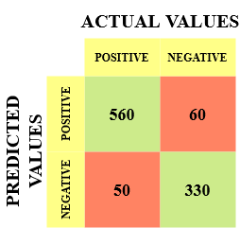
The different values of the Confusion matrix would be as follows:
True Positive (TP) = 560; meaning 560 positive class data points were correctly classified by the model
True Negative (TN) = 330; meaning 330 negative class data points were correctly classified by the model
False Positive (FP) = 60; meaning 60 negative class data points were incorrectly classified as belonging to the positive class by the model
False Negative (FN) = 50; meaning 50 positive class data points were incorrectly classified as belonging to the negative class by the model

Slide 4
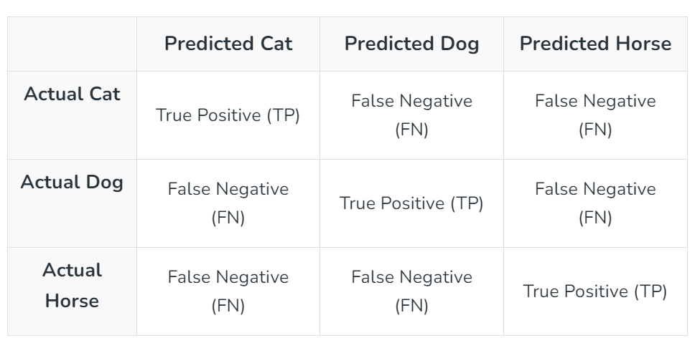
Confusion Matrix For Multi-class Classification

Slide 5
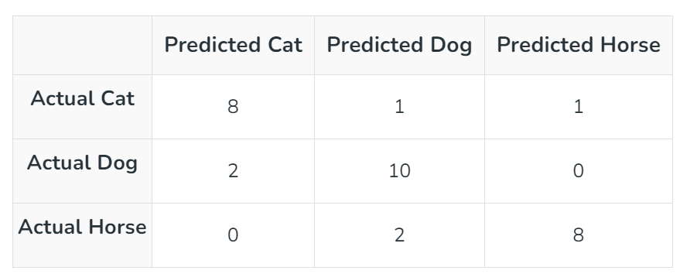
In this scenario:
Cats: 8 were correctly identified, 1 was misidentified as a dog, and 1 was misidentified as a horse.
Dogs: 10 were correctly identified, 2 were misidentified as cats.
Horses: 8 were correctly identified, 2 were misidentified as dogs.

Slide 6
Regression Performance Evaluation Metrics
Mean Absolute Error (MAE)
  It is the average difference between the original and predicted values.
  It measures how far the predictions are from the actual output
  We want to minimize it.
  It doesn’t give you an idea of the direction of the error since you are taking only the absolute values.
  It doesn’t penalize large errors as much as compared to RMSE.

Slide 7

Mean Absolute Error (MAE)
Mathematically, it is represented as:
here,
n is the number of observations
𝑦_{𝑗} is the actual value for sample j
𝑦̂_{𝑗} is the predicted value for sample j

Slide 8
Cross-Validation
It is a resampling procedure used to evaluate machine learning models and access how the model will perform for an independent test dataset
Why Use Cross Validation?
Model Validation: Ensures that our model is not overfitting or underfitting.
Performance Estimation: Provides an estimate of how well our model will perform on unseen data.
Hyperparameter Tuning: Helps in selecting the best hyperparameters for our model by evaluating different combinations.

Slide 9

K-Fold Cross Validation
In K-Fold cross validation, the dataset is randomly divided into K equal-sized subsamples.
Out of the K subsamples, a single subsample is retained as the validation data, and the remaining K-1 subsamples are used as training data.
The cross-validation process is then repeated K times, with each of the K subsamples used exactly once as the validation data.

Slide 10
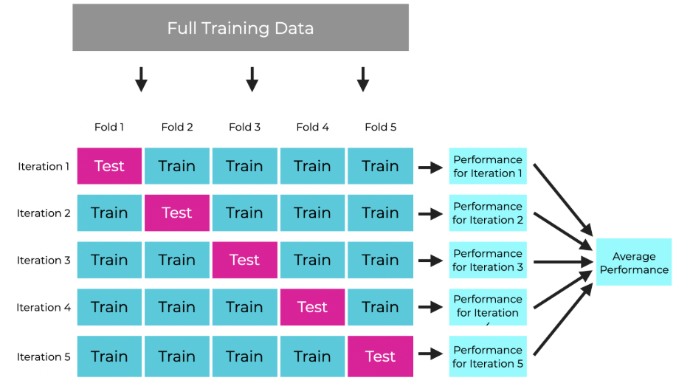

Slide 11
Stratified k-fold cross-validation
Stratified k-fold cross-validation works well for an imbalanced dataset.
In Stratified k-fold cross-validation, the dataset is partitioned into k groups or folds such that the validation data/Test set has an equal number of instances of target class label.
This ensures that one particular class is not over present in the validation or train data especially when the dataset is imbalanced.
The final score is computed by taking the mean of scores of each fold.

Slide 12
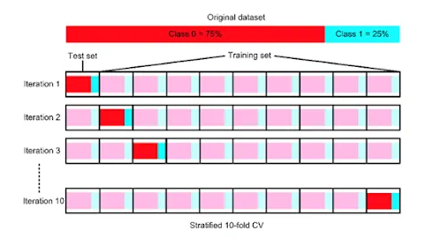

Slide 13
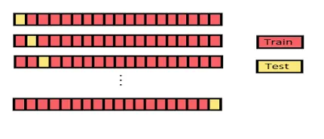
Leave-One-Out Cross Validation (LOOCV)
In LOOCV, a single observation from the original dataset is used as the validation data, and the remaining observations are used as training data.
This process is repeated such that each observation in the dataset is used once as the validation data.

Slide 14

Thank you

